Slide 1
Silhouetize
By: Marius Asadauskas & Julius Oeftiger
Fabrication and Prototyping in the Learning Lab
21.12.2022

Slide 2
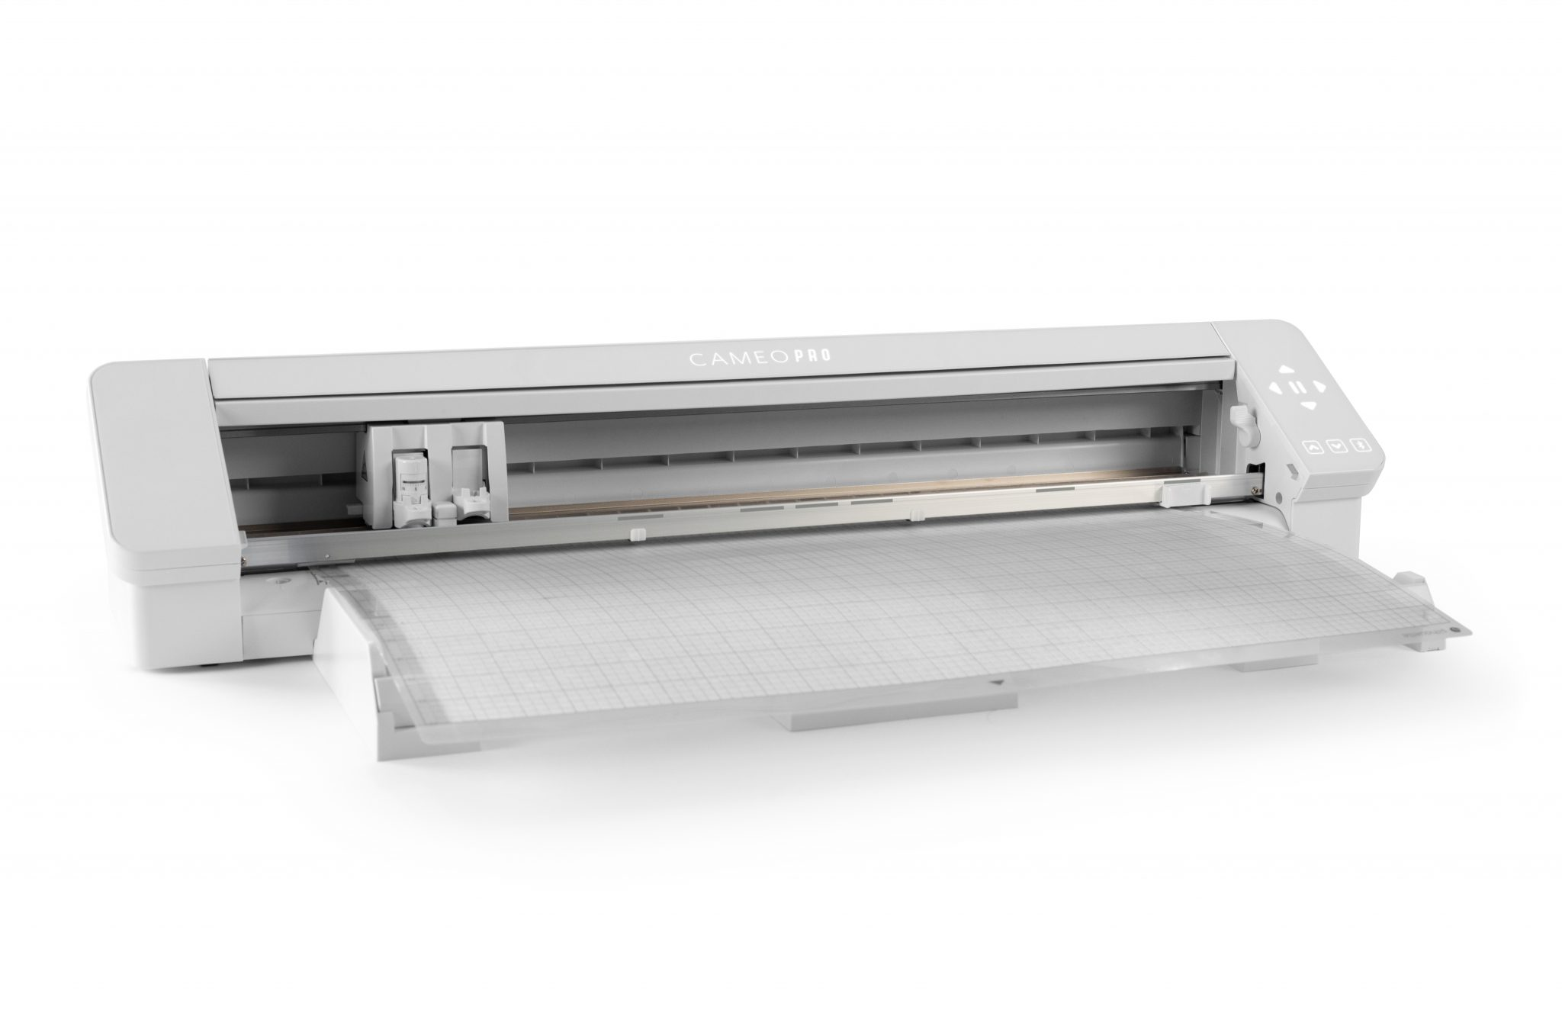
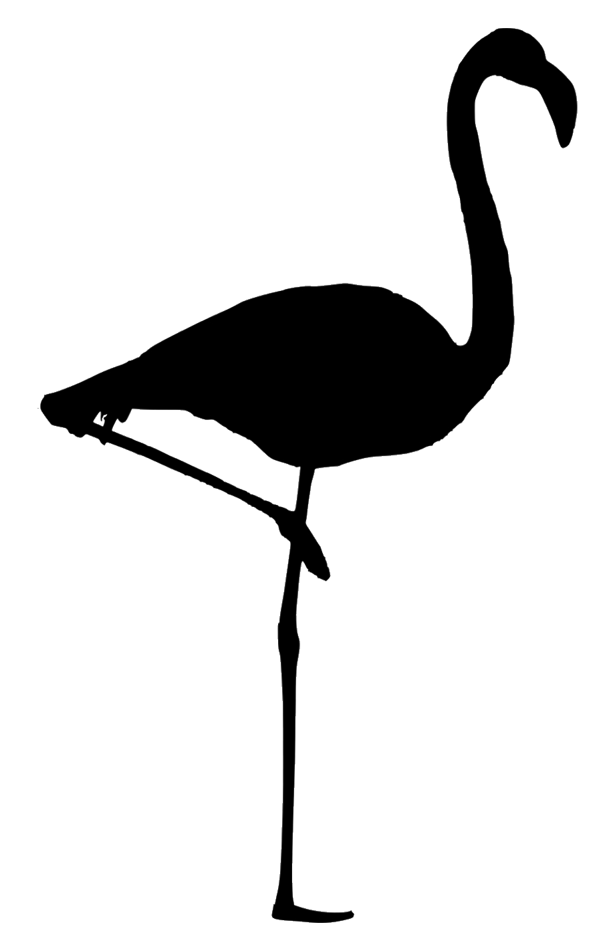
Silhouetize
Silhouette
Automatize
Notes:
[Silhouette]: https://skatkatz.com.au/product/silhouette-cameo-4-pro/
[Flamingo]: https://clipartcraft.com/images/flamingo-clipart-silhouette-8.png/

Slide 3
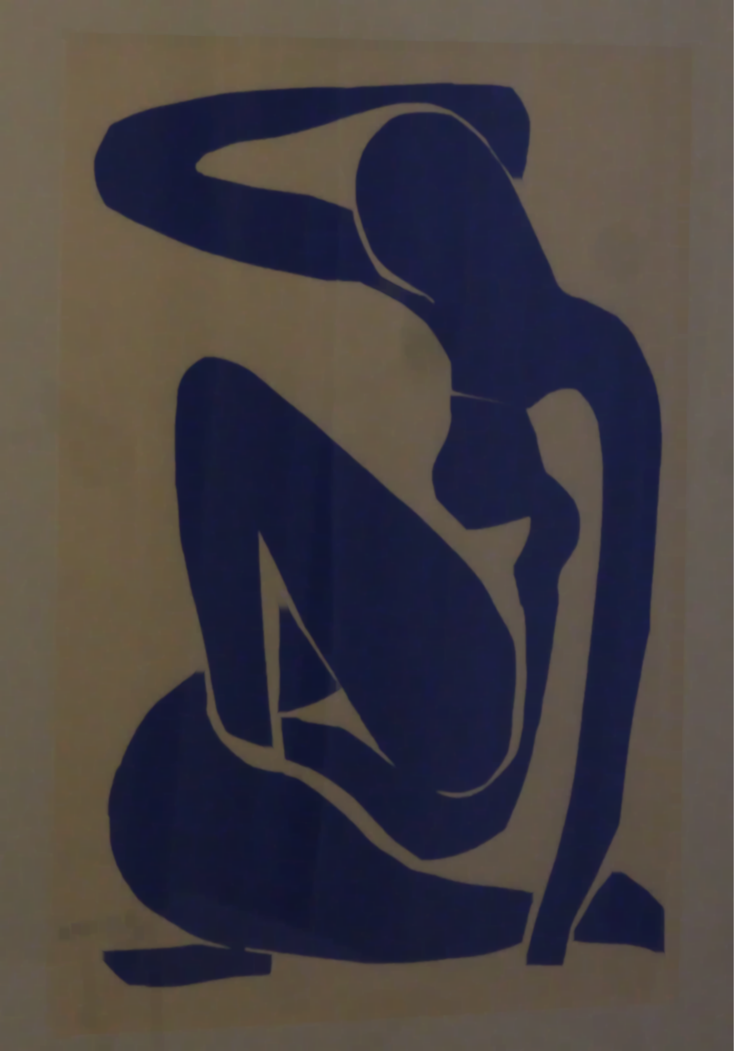


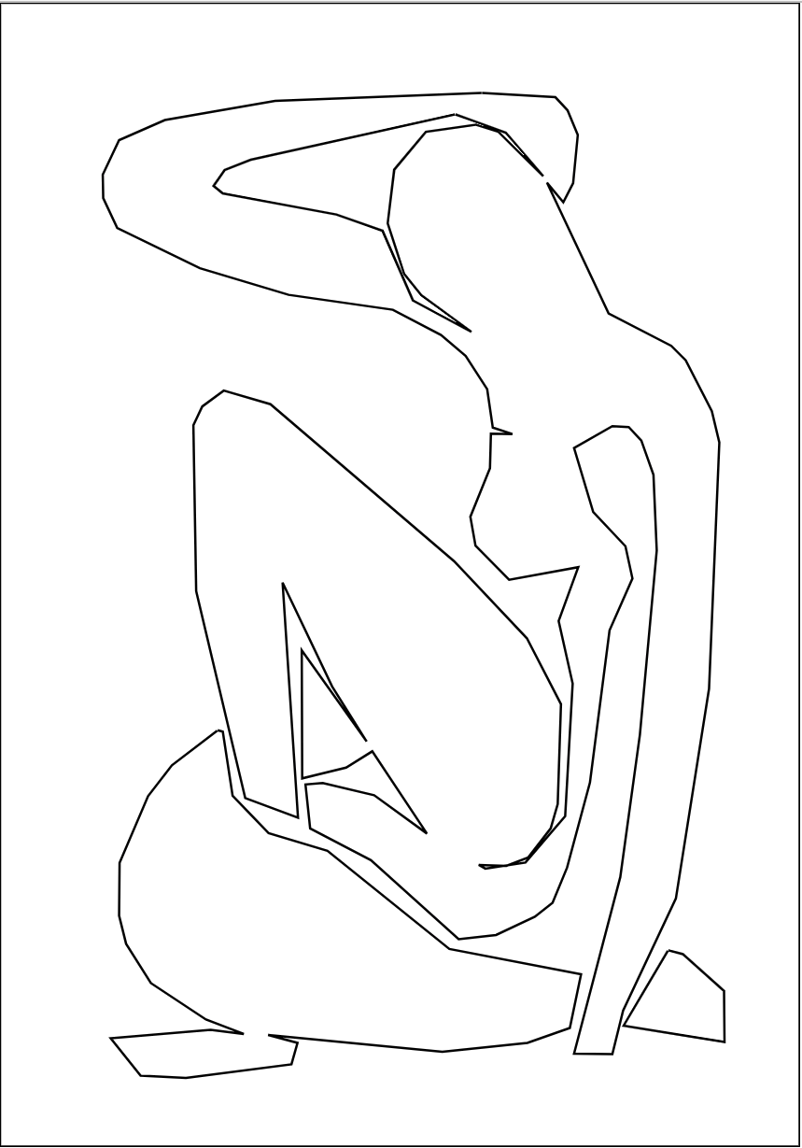
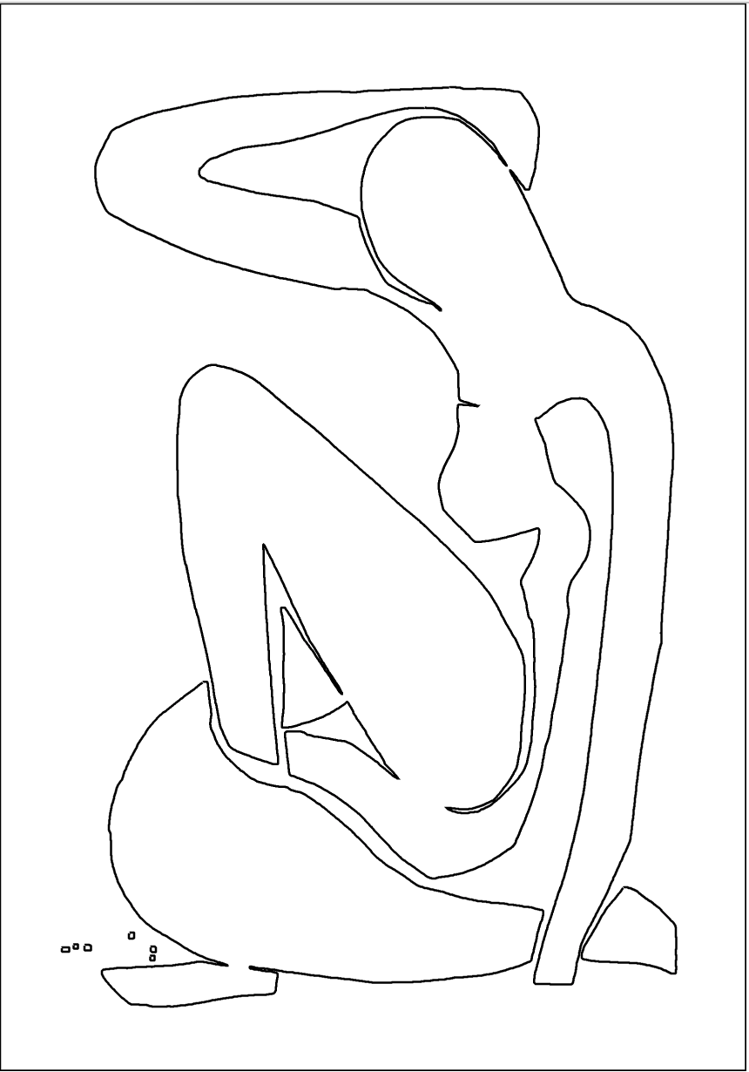

Processing “Pipeline”
Blur and Simplify
Thresholding
Simplify Contours

Slide 4
Blurring
Median blur:
Removes salt-and-pepper noise
Gaussian blur:
Reduces image noise and details
Notes:
[Image]: https://en.wikipedia.org/wiki/Thresholding_(image_processing)#/media/File:Example_of_adaptive_thresholding.png

Slide 5
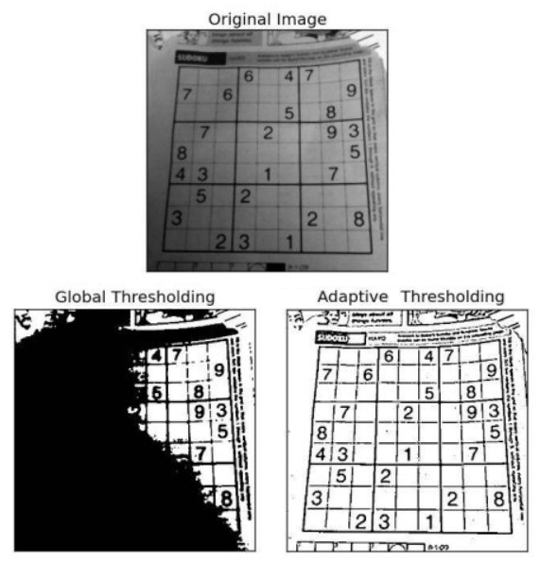
Thresholding
Converts each pixel to TRUE or FALSE
Global thresh.:
Manual I_{n,m}= (I_{n,m} > T)
Otsu
Triangle
Local thresh.:
Median, Gaussian
Sliding kernel
Notes:
[Image]: https://en.wikipedia.org/wiki/Thresholding_(image_processing)#/media/File:Example_of_adaptive_thresholding.png

Slide 6
Simplifying Contours
Dropping short contours
Approximating contours:
Distance between vertices

Slide 7

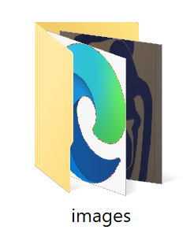

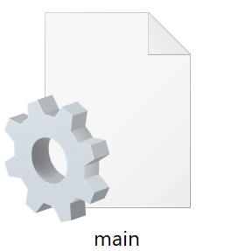
Ecosystem:
Template File
GET / POST
User
Static Files
USB
Manual Interaction

Slide 8
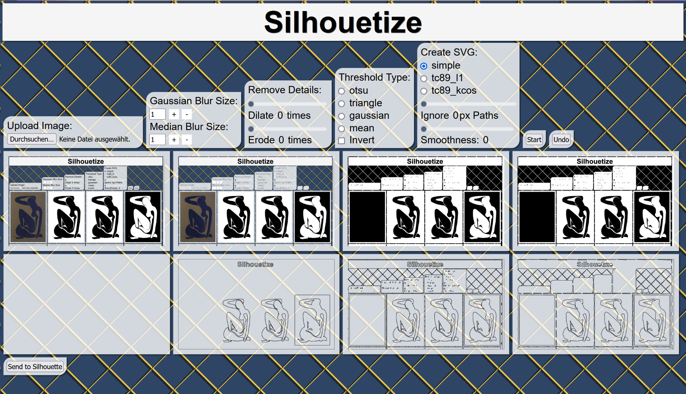
UI Explained

Slide 9
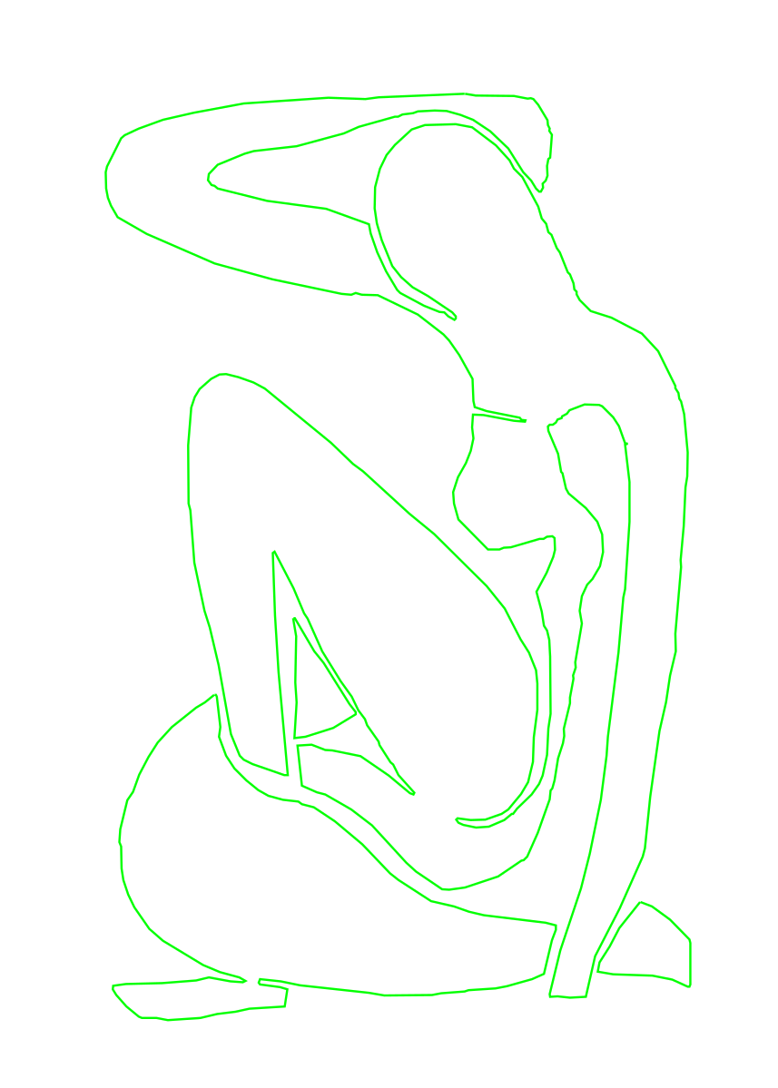
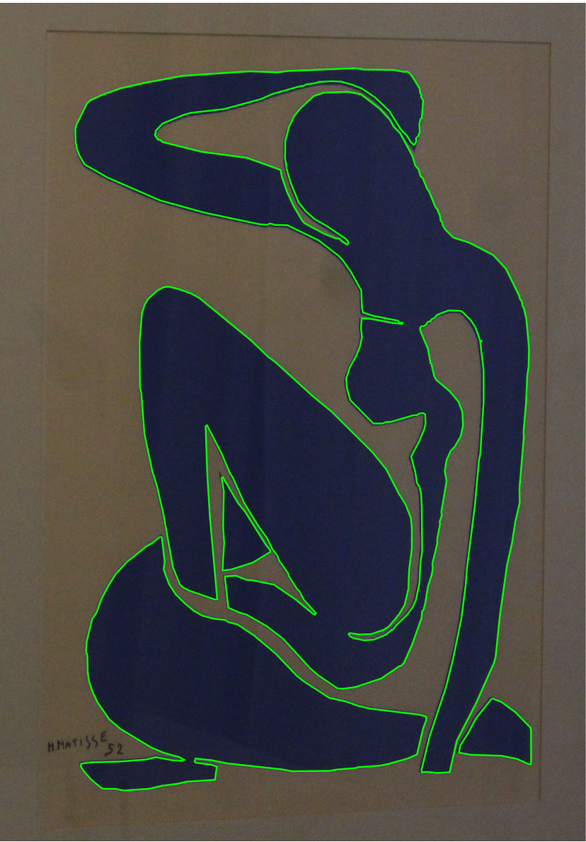
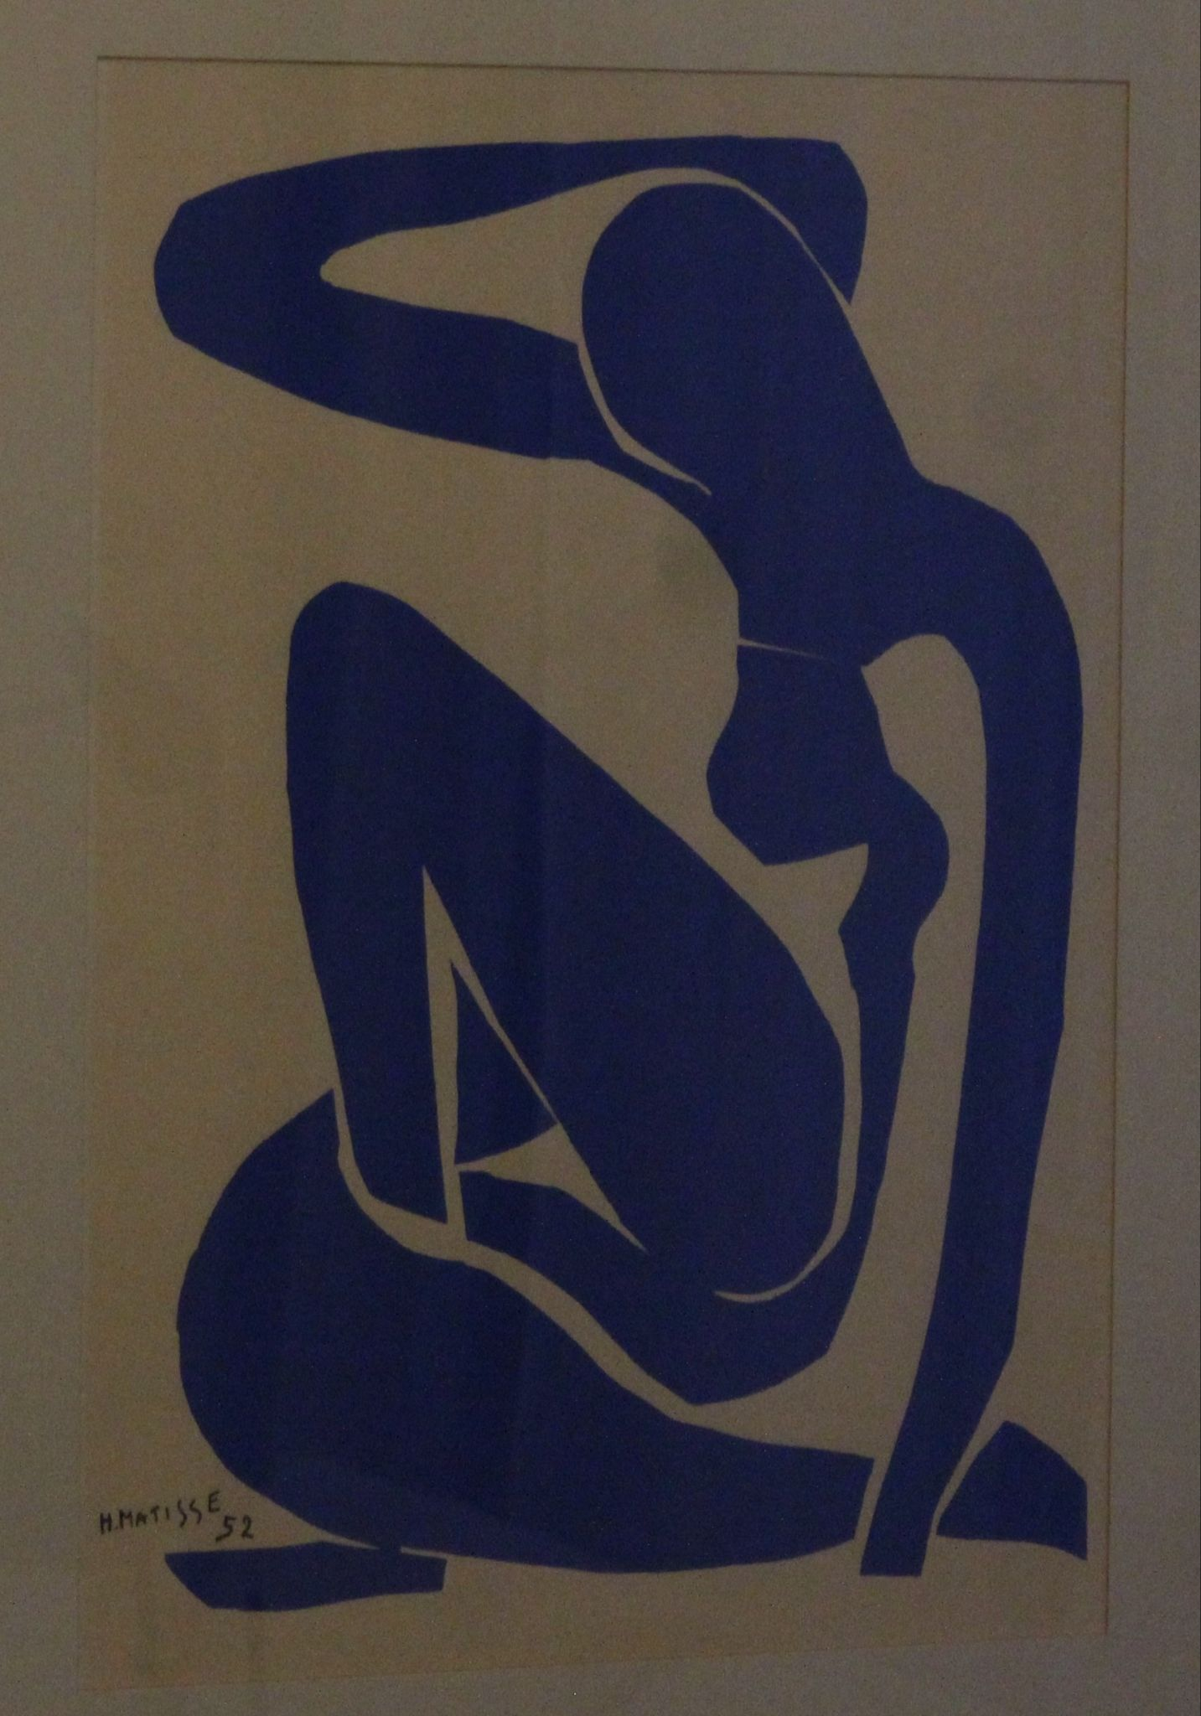
Final Results:

Slide 10
Use Cases:
Fast logo testing
Useful image processing tool / fun
Save on printer ink, US Government spends $1.14 Billion on printer ink [1]
No Silhouette™ software needed
Notes:
[1]: https://www.gao.gov/products/t-ggd-89-34

Slide 11
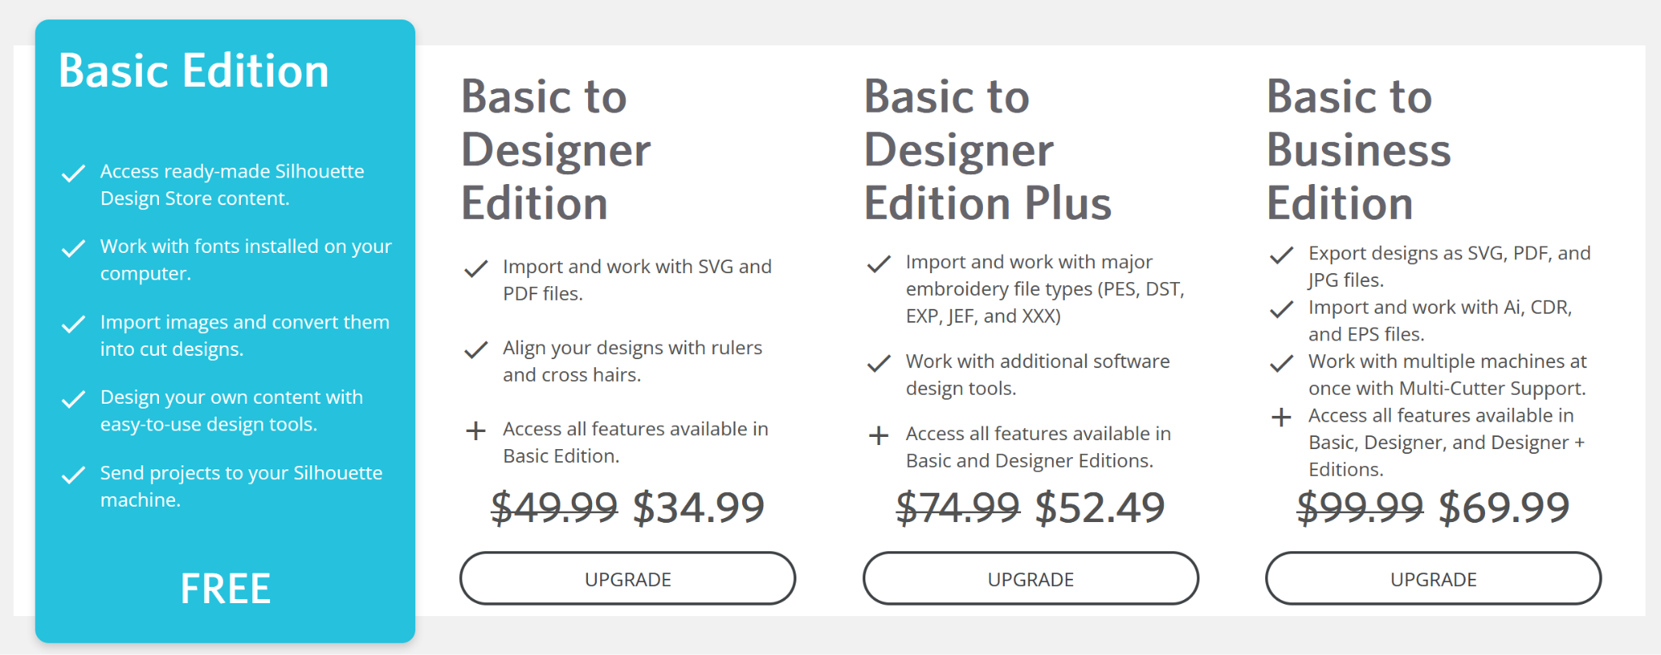
Silhouette Pricing:

Slide 12
THANK YOU FOR LISTENING
AND HAPPY HOLIDAYS

